Slide 1
XML
AT.NET 2012

Slide 2
References
Jim Wilson
jimw@jwhedgehog.com
Dr. Wolfgang Beer
Software Competence Center Hagenberg
Dr. Herbert Praehofer
Institute for System Software
Johannes Kepler University Linz

Slide 3
XML in .NET
.NET makes heavy use of XML
  see ADO.NET, WSDL, UDDI, SOAP, …
The .NET class library provides implementations for standards like:
  XML, XSL, XPath, ...
Both XML processing models are supported:
  DOM (Document Object Model)
  serial access similar to SAX
Namespaces
  System.Xml
  System.Xml.Xsl
  System.Xml.XPath
  System.Xml.Schema
  System.Xml.Serialization
Notes:
Überblick

Slide 4
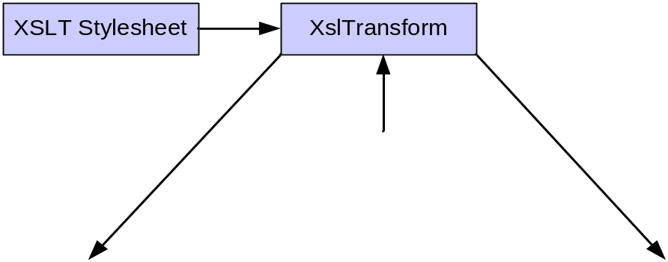
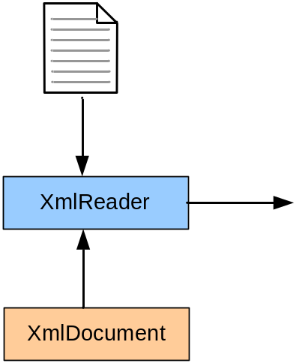
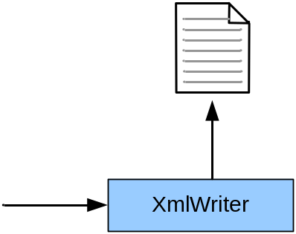
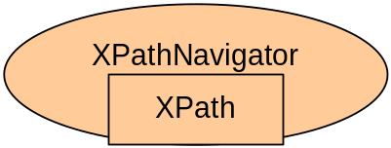
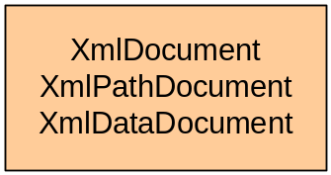
Processing XML Data
XmlReader: Reading XML data
XmlDocument, XmlNode: Object model for XML data (DOM)
XmlWriter: Wrting XML data
XPathNavigator: XPath selections
XslTransform: Transformation of XML documents
Notes:
Überblick

Slide 5
Sequential Reading

Slide 6
XmlReader
Abstract (MustOverride) class
Represents a forward-only document reader
Exposes information only for the current node position
  NodeType, Name, NamespaceURI, Value
Application must handle some lexical issues

Slide 7
XmlReader (cont.)
Read method
  Supports generic document processing
  Reads the next hierarchical node
  Application code must manage details of each node
Attributes must be specifically read
  MoveToFirstAttribute, MoveToNextAttribute
    Iterates through the attribute list
  MoveToAttribute
    Move to a named attribute or attribute position

Slide 8
XmlReader (cont.)
ReadStartElement & ReadEndElement provide element optimizations
  Reader verifies that node is an element
  Overloads support name and namespace verification
ReadElementString
  Encapsulates node type, name & namespace verification
  Reads element start & end tags and text child
  Returns value of text child
MoveToContent
  Skips over white space, comments & Processing Instructions

Slide 9
XmlTextReader
Derived from XmlReader
Most performent .NET XML reader
Adds methods to interrogate file information
  LineNumber, LinePosition, Encoding
Adds methods to simplify large data block handling
  ReadBase64, ReadBinHex, ReadChars

Slide 10
XmlReader
XmlReader for serial parsing
Similar to SAX, but works with a pull mode
Implementations are:
  XmlTextReader: efficient, no immediate storage of elements
  XmlValidatingReader: validates document against DTD or XSD
  XmlNodeReader: reading from an XmlNode (DOM)
Notes:
Überblick

Slide 11
Class XmlReader
public abstract class XmlReader {
public abstract string Name { get; }
public abstract string LocalName { get; }
public abstract string Value { get; }
public abstract XmlNodeType NodeType { get; }
public abstract int AttributeCount { get; }
public abstract int Depth { get; }
public abstract bool Read();
public virtual void Skip();
public abstract string GetAttribute(int i);
public abstract void Close();
...
}
Properties of current element
  full name
  local name
  value
  type
  number of attributes
  depth in document
Reading of next element
Skipping the current element and its subs
Getting the element‘s attributes
Closing the reader
Notes:
Überblick

Slide 12
Example XmlTextReader
Reading the file addressbook.xml
Output of the values of all lastname elements
Output
XML file
<?xml version='1.0' encoding="utf-8"?>
<addressbook owner="1">
<person id="1">
<firstname>Wolfgang</firstname>
<lastname>Beer</lastname>
<email>beer@uni-linz.at</email>
</person>
<person id="2">
<firstname>Dietrich</firstname>
<lastname>Birngruber</lastname>
<email>birngruber@uni-linz.at</email>
</person>
<person id="3">
<firstname>Hanspeter</firstname>
<lastname>Moessenboeck</lastname>
<email>moessenboeck@uni-linz.at</email>
</person>
<person id="4">
<firstname>Albrecht</firstname>
<lastname>Woess</lastname>
<email>woess@uni-linz.at</email>
</person>
</addressbook>
XmlTextReader r;
r = new XmlTextReader("addressbook.xml");
while (r.Read()) {
if (r.IsStartElement("lastname")) {
r.Read(); // read the name
Console.Write("{0}, ", r.Value);
}
}
r.Close();
Beer, Birngruber, Moessenboeck, Woess,
Notes:
Überblick

Slide 13
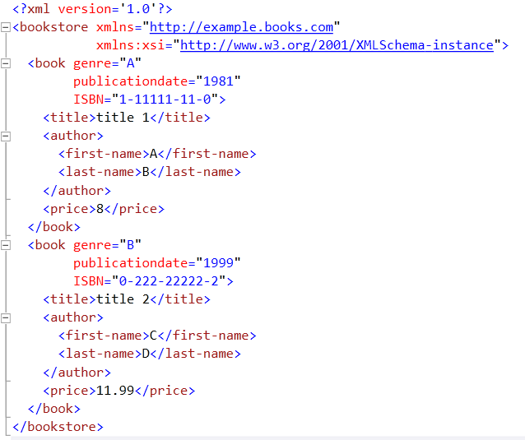
Data.xml

Slide 14
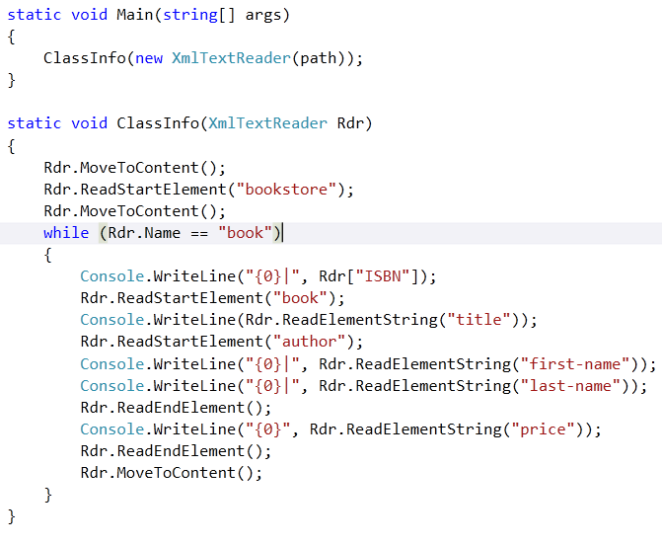
XmlTextReader

Slide 15
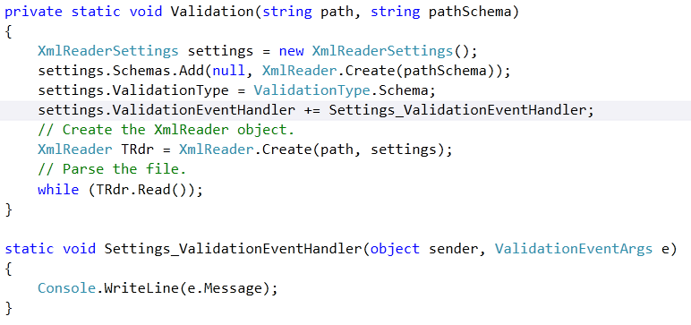
XmlReaderSettings

Slide 16
Sequential Writing

Slide 17
XmlWriter
Abstract (MustOverride) class
Represents a forward-only, sequential document writer
Checks wellformidness of generated content
Does not validate

Slide 18
XmlWriter (cont.)
Provides “Write” methods for the various node types
  WriteStartElement, WriteEndElement, WriteString, WriteComment, etc.
  WriteElementString writes start tag, end tag and character child in a single call
WriteDocType method supports writing DTD entries
WriteRaw method allows pass-through writing of raw XML
  Writer does not check wellformidness of raw writes

Slide 19
XmlTextWriter
Derives from XmlWriter
Adds Formatting control
  Formmatting, Indentation, IndentChar & QuoteChar properties
Adds methods to simplify large data block handling
  WriteBase64, WriteBinHex, WriteChars

Slide 20
XmlTextWriter
static void WriteClass(XmlTextWriter wrt)
{
wrt.Formatting = Formatting.Indented ;
wrt.WriteStartDocument() ;
wrt.WriteStartElement("Classes") ;
wrt.WriteAttributeString("name", ".NET XML") ;
wrt.WriteElementString("Students", "12") ;
wrt.WriteElementString("Location", "Maine Bytes") ;
wrt.WriteElementString("Instructor", "Jim") ;
}
static void Main(string[] args)
{
XmlTextWriter wrt = new XmlTextWriter(Path, Encoding.UTF8) ;
WriteClass(wrt) ;
wrt.Close() ;
}
<?xml version="1.0" encoding="utf-8"?>
<Classes name=".NET XML">
<Students>12</Students>
<Location>Maine Bytes</Location>
<Instructor>Jim</Instructor>
</Classes>

Slide 21
Document Object Model (DOM)
A hierarchy of classes representing the various document nodes
Classes in System.Xml
Well-suited for random access and dynamic modification
All node classes inherit from XmlNode
The only creatable class is XmlDocument
Contents validated if populated through XmlValidatingReader

Slide 22
.NET DOM Class Hierarchy
Classes in System.Xml
System.Object
XmlNode
XmlLinkedNode
XmlAttribute
XmlElement
XmlDocument
XmlDecleration
XmlDocumentFragment
XmlDocumentType
XmlEntity
XmlEntityReference
XmlNotation
XmlProcessingInstruction
XmlCharacterData
XmlCharacterData
XmlCDataSection
XmlComment
XmlSignificantWhiteSpace
XmlText
XmlWhiteSpace

Slide 23
DOM – Document Object Model
Construction of object structure in main memory
  + efficient manipulation of XML data
  size limitations
XML elements are represented by XmlNode objects
XmlDocument object represents whole XML document
Example: Loading an XML document:
XmlDocument xDoc = new XmlDocument();
xDoc.Load("file.xml");
Notes:
Überblick

Slide 24
Example DOM
<?xml version='1.0' encoding="utf-8"?>
<addressbook owner="1">
<person id="1">
<firstname>Wolfgang</firstname>
<lastname>Beer</lastname>
<email>beer@uni-linz.at</email>
</person>
<person id="2">
<firstname>Dietrich</firstname>
<lastname>Birngruber</lastname>
<email>birngruber@uni-linz.at</email>
</person>
</addressbook>
document
xml
addressbook
owner
person
person
id
id
firstname
firstname
lastname
lastname
email
email
Notes:
Überblick

Slide 25
XmlNode
XmlNode
  Abstract (MustOverride) class that generically represents each node
  Properties & methods to manage node relationships
  Properties expose node type, name, namespace and content
  Meaning of name and content vary depending on node type

Slide 26
XmlNode Name & Value Definitions
NodeType | Name | Value
Element | Element QName | null
Attribute | Attribute QName | Attribute Value
Text | #text | Text
Document | #document | null
XmlDecleration | xml | Declaration Content
Comment | #comment | Comment Text
Processing Instruction | PI Target | PI Data

Slide 27
XmlNode Relationships
Relationships managed through read-only XmlNode reference properties
  OwnerDocument
  ParentNode
  Siblings
    PreviousSibling, NextSibling
  Children
    FirstChild, LastChild

Slide 28
Class XmlNode (1)
public abstract class XmlNode : ICloneable, IEnumerable, IXPathNavigable {
public abstract string Name { get; }
public abstract string LocalName { get; }
public abstract XmlNodeType NodeType { get; }
public virtual string Value { get; set; }
public virtual XmlAttributeCollection Attributes { get; }
public virtual XmlDocument OwnerDocument { get; }
public virtual bool IsReadOnly { get; }
public virtual bool HasChildNodes { get; }
public virtual string Prefix { get; set; }
public virtual XmlNodeList ChildNodes { get; }
public virtual XmlNode FirstChild { get; }
public virtual XmlNode LastChild { get; }
public virtual XmlNode NextSibling { get; }
public virtual XmlNode PreviousSibling { get; }
public virtual XmlNode ParentNode { get; }
public virtual XmlElement this[string name] { get; }
public virtual XmlElement this[string localname, string ns] { get; }
…
Properties of node
  full name
  local name
  type
  value
  attributes
  …
Accessing adjacent nodes
  children
  siblings
  parent
  named subnodes
Notes:
Überblick

Slide 29
Class XmlNode (2)
...
public virtual XmlNode AppendChild(XmlNode newChild);
public virtual XmlNode PrependChild(XmlNode newChild);
public virtual XmlNode InsertAfter(XmlNode newChild,
XmlNode refChild);
public virtual XmlNode InsertBefore(XmlNode newChild,
XmlNode refChild);
public virtual XmlNode RemoveChild(XmlNode oldChild);
public virtual void RemoveAll();
public XPathNavigator CreateNavigator();
public XmlNodeList SelectNodes(string xpath);
public XmlNode SelectSingleNode(string xpath);
public abstract void WriteContentTo(XmlWriter w);
public abstract void WriteTo(XmlWriter w);
...
}
Adding and removing nodes
Selection of nodes
Writing
public enum XmlNodeType {
Attribute, CDATA, Comment, Document, DocumentFragment, DocumentType, Element,
EndElement, EndEntity, Entity, EntityReference, None, Notation, ProcessingInstruction,
SignificantWhitespace, Text, Whitespace, XmlDeclaration
}
Notes:
Überblick

Slide 30
Class XmlDocument (1)
public class XmlDocument : XmlNode {
public XmlDocument();
public XmlElement DocumentElement { get; }
public virtual XmlDocumentType DocumentType { get; }
public virtual void Load(Stream in);
public virtual void Load(string url);
public virtual void LoadXml(string data);
public virtual void Save(Stream out);
public virtual void Save(string url);
Root element
Document type
Loading the XML data
Saving
Notes:
Überblick

Slide 31
Class XmlDocument (2)
public virtual XmlDeclaration CreateXmlDeclaration
(string version, string encoding, string standalone);
public XmlElement CreateElement(string name);
public XmlElement CreateElement
(string qualifiedName, string namespaceURI);
public virtual XmlElement CreateElement
(string prefix, string lName, string nsURI);
public virtual XmlText CreateTextNode(string text);
public virtual XmlComment CreateComment(string data);
Creation of
  declaration
  elements
  text nodes
  comments
Events for changes
public event XmlNodeChangedEventHandler NodeChanged;
public event XmlNodeChangedEventHandler NodeChanging;
public event XmlNodeChangedEventHandler NodeInserted;
public event XmlNodeChangedEventHandler NodeInserting;
public event XmlNodeChangedEventHandler NodeRemoved;
public event XmlNodeChangedEventHandler NodeRemoving;
}
Notes:
Überblick

Slide 32
DOM Tree Walker
void Main(string[] args)
{
XmlDocument dom = new XmlDocument() ;
dom.Load(@"C:\DataFiles\Classes.xml") ;
TreeWalk(dom) ;
}
void TreeWalk(XmlNode node)
{
if (node == null)
return ;
Console.WriteLine("Type: {0}\tName: {1}\tValue: {2}",
node.NodeType, node.Name, node.Value) ;
TreeWalk(node.FirstChild) ;
TreeWalk(node.NextSibling) ;
}

Slide 33
XmlNode Collections
Child Nodes
  childNodes property returnes an XmlNodeList
    Nodes accessed either through item property or indexer []
  XmlNode also exposes an indexer [ ] to access children
    Invoice[“Price”]
Attribute Nodes
  Attributes property returns an XmlAttributeCollection
    Attributes accessed through an indexer [] by either name or position
    Attributes added or changed through SetNamedItem method

Slide 34
DOM Tree Walker Using Collections
static void CollectWalk(XmlNode node)
{
Console.WriteLine("Type: {0}\tName: {1}\tValue: {2}",
node.NodeType, node.Name, node.Value) ;
if (node.HasChildNodes)
{
XmlNodeList nodeList = node.ChildNodes ;
foreach (XmlNode child in nodeList)
CollectWalk(child) ;
}
}

Slide 35
DOM Tree Walker Using Collections
static void CollectWalk(XmlNode node)
{
Console.WriteLine("Type: {0}\tName: {1}\tValue: {2}",
node.NodeType, node.Name, node.Value) ;
if (node.Attributes != null)
foreach (XmlAttribute Attr in node.Attributes)
Console.WriteLine("\tAttr: {0}={1}",
Attr.Name, Attr.Value) ;
if (node.HasChildNodes)
{
XmlNodeList nodeList = node.ChildNodes ;
foreach (XmlNode child in nodeList)
CollectWalk(child) ;
}
}
Notes:
Überblick

Slide 36
DOM Modification
Node Creation
  New nodes must be created by XmlDocument
XmlNode Placement Methods
  InsertBefore, InserAfter
  PrependChild, AppendChild
  RemoveChild, ReplaceChild, RemoveAll
Modification events managed through delegates
  NodeChanging, NodeChanged
  NodeInserting, NodeInserted
  NodeRemoving, NodeRemoved

Slide 37
Example Creation of XML Document
XmlDocument enables building XML documents
Create document and add declaration
Create root element
Create and add Person element and subelements
XmlDocument doc = new XmlDocument();
XmlDeclaration decl = doc.CreateXmlDeclaration("1.0", null, null);
doc.AppendChild(decl);
XmlElement rootElem = doc.CreateElement("addressbook");
rootElem.SetAttribute("owner", "1");
doc.AppendChild(rootElem);
XmlElement person = doc.CreateElement("person");
person.SetAttribute("id", "1");
XmlElement f = doc.CreateElement("firstname");
f.AppendChild(doc.CreateTextNode("Wolfgang"));
person.AppendChild(f);
XmlElement l = doc.CreateElement("lastname");
...
<?xml version="1.0" encoding="IBM437"?>
<addressbook owner="1">
<person id="1">
<firstname>Wolfgang</firstname>
<lastname>Beer</lastname>
<email>beer@uni-linz.at</email>
</person>
</addressbook>
Notes:
Überblick

Slide 38
DOM Modification
Node Creation
  New nodes must be created by XmlDocument
XmlNode Placement Methods
  InsertBefore, InserAfter
  PrependChild, AppendChild
  RemoveChild, ReplaceChild, RemoveAll
Modification events managed through delegates
  NodeChanging, NodeChanged
  NodeInserting, NodeInserted
  NodeRemoving, NodeRemoved

Slide 39
XPathNavigator

Slide 40
XPathNavigator
Classes in System.Xml.XPath
Read-only
Provides a scrolling cursor “window” over the document
Great support for document filtering
Best XPath support
Content is interpreted according to XPath specification

Slide 41
Creating the Navigator
XPathNavigator is an abstract (MustOverride) class
Must be factoried from another object
Factory objects must implement IXPathNavogable
  XPathDocument implementation creates an efficient navigator cache
    Can be populated from XmlValidatingReader
  XmlNode implementation creates a navigator over the corresponding DOM instance.

Slide 42
Cursor Navigation
Cursor is controlled by “MoveTo…” methods
  MoveToRoot
  MoveToParent
  MoveToFirstChild
  Siblings
    MoveToFirst, MoveToPrevious, MoveToNext
  Attributes
    MoveToFirstAttribute, MoveToNextAttribute

Slide 43
Cursor Navigation
Cursor is controlled by “MoveTo…” methods
  MoveToRoot
  MoveToParent
  MoveToFirstChild
  Siblings
    MoveToFirst, MoveToPrevious, MoveToNext
  Attributes
    MoveToFirstAttribute, MoveToNextAttribute

Slide 44
Navigator Tree Walker
static void Main(string[] args)
{
XPathDocument doc = new XPathDocument(Path) ;
XPathNavigator nav = doc.CreateNavigator() ;
TreeWalk(nav) ;
}
static void TreeWalk(XPathNavigator nav)
{
Console.WriteLine("Type: {0}\tName: {1}\tValue: {2}",
nav.NodeType, nav.Name, nav.Value) ;
if (nav.HasChildren)
{
nav.MoveToFirstChild() ;
TreeWalk(nav) ;
nav.MoveToParent() ;
}
if (nav.MoveToNext())
TreeWalk(nav) ;
}

Slide 45
XPath
XPath is language for identification of elements in an XML document
XPath expression (location path) selects a set of nodes
A location path consists of location steps, which are separated by "/"
//step/step/step/
Examples of location paths are:
  "*" selects all nodes
  "/addressbook/*" selects all elements under the addressbook elements
  "/addressbook/person[1]" returns the first person element of the addressbook elements
  "/addressbook/*/firstname“ returns the firstname elements under the addressbook elements
Notes:
Überblick

Slide 46
XPath Support
SelectNodes
  Returns an XmlNodeList containing selection result
SelectSingleNode
  Returns an XmlNode containing only the first node in the selection result
void ShowStudentNames (XmlNode node)
{
XmlNodeList nl = node.SelectNodes(“Student/@Name”) ;
foreach (XmlNode n in nl)
Console.WriteLine(“Student:{0}”, n.Value) ;
}

Slide 47
XPathNavigator
Class XPathNavigator allows navigation in document
IXPathNavigable (implemented by XmlNode) returns XPathNavigator
public abstract class XPathNavigator : ICloneable {
public abstract string Name { get; }
public abstract string Value { get; }
public abstract bool HasAttributes { get; }
public abstract bool HasChildren { get; }
public virtual XPathNodeIterator Select(string xpath);
public virtual XPathNodeIterator Select(XPathExpression expr);
public virtual XPathExpression Compile(string xpath);
public abstract bool MoveToNext();
public abstract bool MoveToFirstChild();
public abstract bool MoveToParent();
…
}
Properties of current node
Selection of nodes by XPath expression
Compilation of XPath expression
Moving to adjacent nodes
public interface IXPathNavigable {
XPathNavigator CreateNavigator();
}
Notes:
Überblick

Slide 48
Example XPathNavigator
Load XmlDocument and create XPathNavigator
Select firstname elements, iterate over selected elements and put out name values
For better run-time efficiency compile expression and use compiled expression
XmlDocument doc = new XmlDocument();
doc.Load("addressbook.xml");
XPathNavigator nav = doc.CreateNavigator();
XPathNodeIterator iterator = nav.Select("/addressbook/*/firstname");
while (iterator.MoveNext())
Console.WriteLine(iterator.Current.Value);
Wolfgang Dietrich Hanspeter Albrecht
XPathExpression expr = nav.Compile("/addressbook/person[firstname='Wolfgang']/email");
iterator = nav.Select(expr);
while (iterator.MoveNext()) Console.WriteLine(iterator.Current.Value);
beer@uni-linz.at
Notes:
Überblick

Slide 49
XML Transformation with XSL
XSLT is XML language for transformation of XML documents
XSL stylesheet is an XML document with a set of rules
Rules (templates) define transformation of XML elements
XSLT is based on XPath;
XPath expressions define the premises of the rules (match)
In the rule body the generation of the transformation result is defined
XSL stylesheet
<xsl:stylesheet version="1.0" xmlns:xsl="http://www.w3.org/1999/XSL/Transform">
<xsl:template
match=xpath-expression>
construction of transformed elements
</xsl:template>
</xsl:stylesheet>
Notes:
Überblick

Slide 50
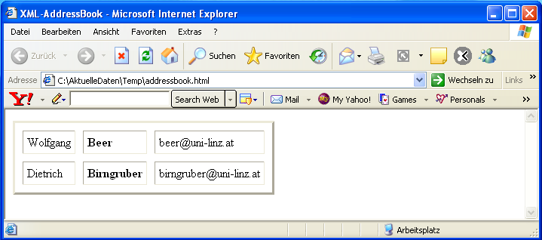
Example Transformation
Original XML document
generated HTML document
<?xml version='1.0' encoding="utf-8"?>
<addressbook owner="1">
<person id="1">
<firstname>Wolfgang</firstname>
<lastname>Beer</lastname>
<email>beer@uni-linz.at</email>
</person>
<person id="2">
<firstname>Dietrich</firstname>
<lastname>Birngruber</lastname>
<email>birngruber@uni-linz.at</email>
</person>
</addressbook>
<html>
<head>
<META http-equiv="Content-Type"
content="text/html; charset=utf-8">
<title>XML-AddressBook</title>
</head>
<body>
<table border="3" cellspacing="10" cellpadding="5">
<tr>
<td>Wolfgang</td>
<td><b>Beer</b></td>
<td>beer@uni-linz.at</td>
</tr>
<tr>
<td>Dietrich</td>
<td><b>Birngruber</b></td>
<td>birngruber@uni-linz.at</td>
</tr>
</table>
</body>
</html>
Notes:
Überblick

Slide 51
Example XSL Stylesheet
<xsl:stylesheet version="1.0" xmlns:xsl="http://www.w3.org/1999/XSL/Transform">
  <xsl:template match="/">
  <html>
  <head> <title>XML Address Book</title> </head>
  <body>
  <table border="3" cellspacing="10" cellpadding="5">
  <xsl:apply-templates/>
  </table>
  </body>
  </html>
  </xsl:template>
  <xsl:template match="addressbook">
  <xsl:apply-templates select="person"/>
  </xsl:template>
  <xsl:template match="person">
  <tr>
  <td> <xsl:value-of select="firstname"/> </td>
  <td> <b><xsl:value-of select="lastname"/></b> </td>
  <td> <xsl:value-of select="email"/> </td>
  </tr>
  </xsl:template>
</xsl:stylesheet>
Notes:
Überblick

Slide 52
Class XslCompiledTransform
Class XslCompiledTransform in namespace System.Xml.Xsl
realizes XSL transformation
  XslCompiledTransform xslt = new XslCompiledTransform();
  xslt.Load("addressbook.xslt");
  xslt.Transform(
  "addressbook.xml",
  "addressbook.html"
  );
Loading the stylesheet
Transformation with
  reading of XML file
  writing HTML file

